Slide 1
Uganda Crop Yield Analysis – A data driven approach
By King`ori Charity

Slide 2
Problem Statement
Region: Karamoja is highly food-insecure
Issue: Low crop productivity due to droughts, pests and diseases
Challenge for NGOs: Lack of comprehensive data to prioritize interventions

Slide 3
Exploring Agricultural Productivity
Objectives:
The goal of this presentation is too explore agricultural productivity, particularly maize and sorghum and then provide actionable insights based on the data

Slide 4

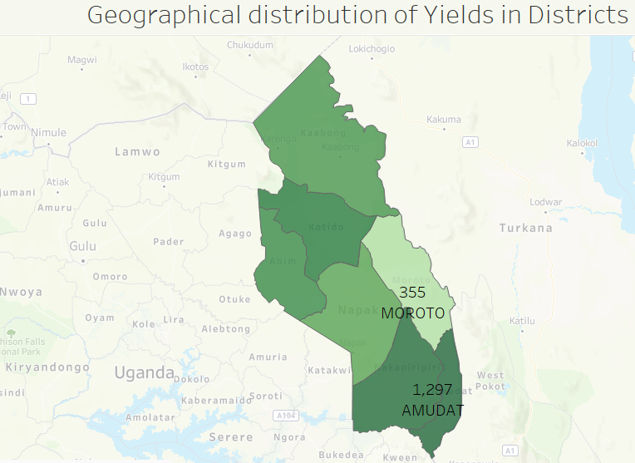
Research Findings and Insights
1. District maize yields
While Amudat District has the highest maize yield, Moroto District has the lowest maize yield

Slide 5
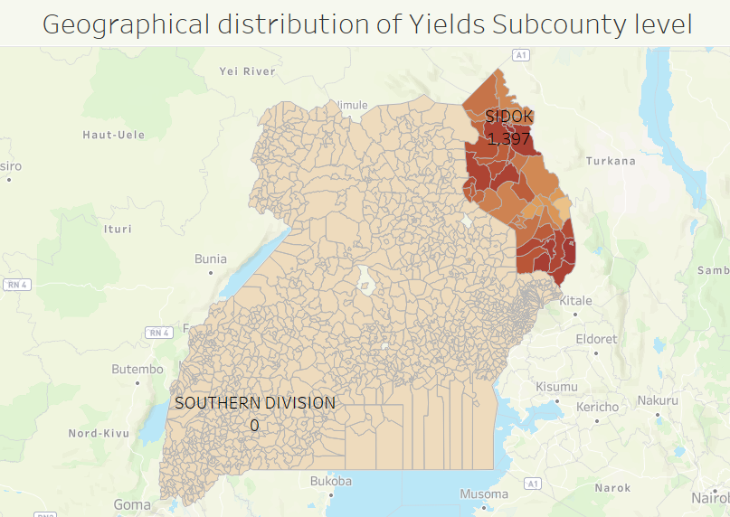
Cont …
2. Subcounty maize yields
The Southern division subcounty has the lowest maize yield followed by the Northern division.
Sidok has the highest maize yields

Slide 6
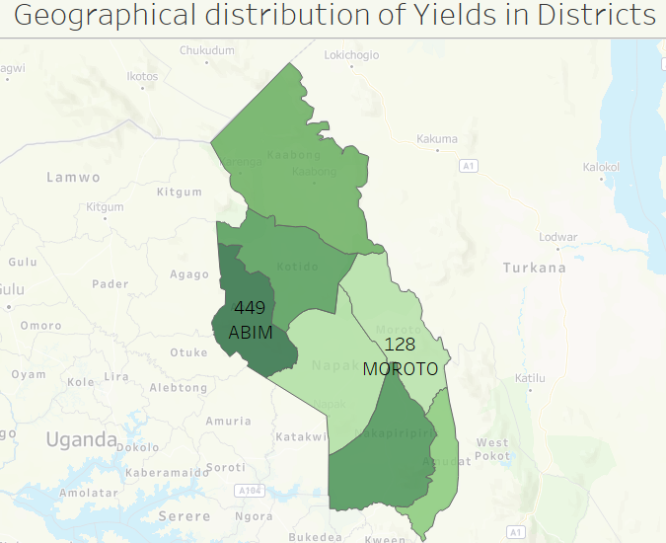
Cont …
3. District Sorghum Yields
After visualization, Moroto was found to have the highest sorghum yield and Abim having the lowest yields

Slide 7
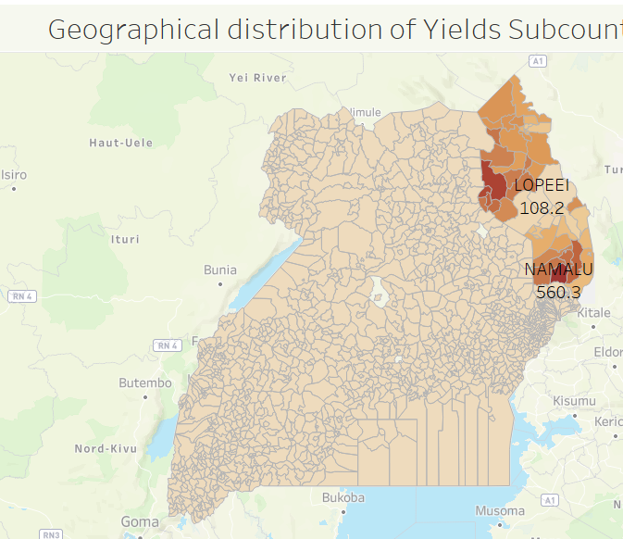
Cont …
4. Subcounty Sorghum Yields
Based on the distribution of Sorghum yields, Lopeei turned out to be the leading in Sorghum production and Namulu has the least yields.

Slide 8
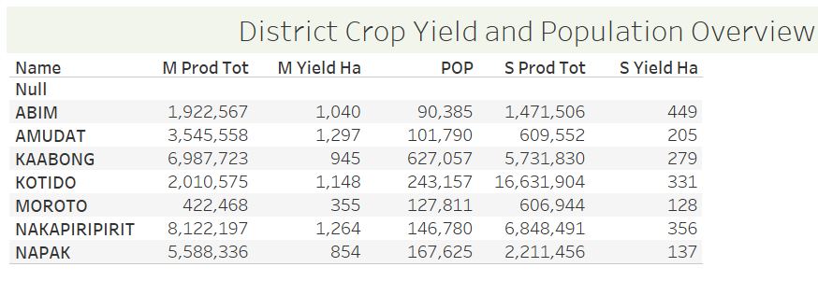
Crop Yields Overview
Larger crop areas have high maize yields and sorghum yields.
Districts with higher maize yields tend to have high sorghum yields

Slide 9
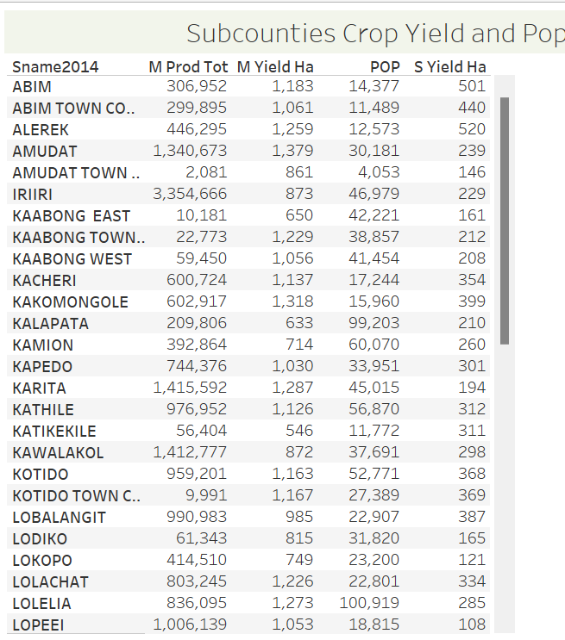
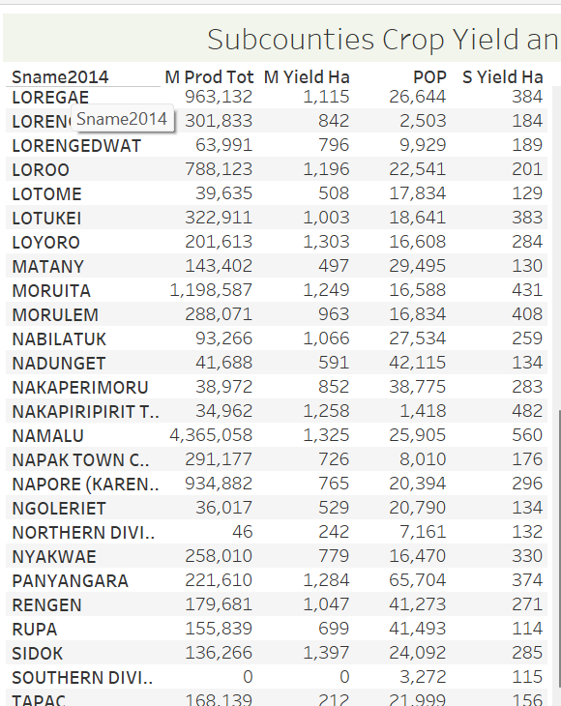
Cont …
A larger crop area generally has higher yields for both maize and sorghum at the subcounty level.

Slide 10
Recommendations
Strategic Crop Expansion: Prioritize expanding crop cultivation in sub-counties and districts where current yields are high or show significant growth potential. Ensure that such expansions are backed by sufficient resources, infrastructure, and support to enhance overall productivity.
Investigate Factors Beyond Population: Analyze and address non-population factors influencing maize yields, such as soil health, climate conditions, and pest prevalence, to improve yield outcomes.
Invest in Agricultural Innovation: Enhance research and development efforts to create crop varieties that withstand drought and pest challenges. Invest in advanced agricultural technologies for accurate yield forecasting and optimized crop management.

Slide 11
Conclusion
The analysis of maize and sorghum yields across Uganda highlights significant variations in productivity at both district and subcounty levels. This assessment provides a comprehensive view of crop performance, which is crucial for understanding regional agricultural dynamics and informing future agricultural strategies.

